Slide 1
For the listening benefit of webinar attendees, we have muted all lines and will be starting our presentation shortly.
This helps prevent background noise (e.g., unmuted phones or phones put on hold) during the webinar.
This also means we are unable to hear you during the webinar.
Please submit your questions directly through the webinar platform only.
How to submit questions:
Open the Q&A feature at the bottom of your screen, type your question related to today’s training webinar and hit “enter.”
Once your question is answered, it will appear in the “Answered” tab.
All questions will be answered by the end of the webinar.

Slide 2
The BlueCard® Program
April 2025
Blue Cross and Blue Shield of Louisiana is an independent licensee of the Blue Cross Blue Shield Association.
HEDIS® is a registered trademark of the National Committee for Quality Assurance (NCQA).
CPT® Only copyright 2025 American Medical Association. All rights reserved.

Slide 3
Welcome!
Today’s presentation will take you on a journey through:
How the BlueCard Program Works
Identifying Members
Using iLinkBlue
Claims
Online Resources
Provider Support

Slide 4
How the BlueCard Program works

Slide 5
What is the BlueCard Program?
DID YOU KNOW?
More than 430,000 members from other Blue Plans reside in Louisiana.
A national program that enables members of one Blue Cross and Blue Shield (BCBS) plan to obtain in-network healthcare services while traveling or living in another BCBS Plan service area.
It links participating healthcare providers with other Blue Plans across the country, and in more than 200 countries and territories worldwide, through a single electronic network for professional, outpatient and inpatient claims processing and reimbursement.
Members have access to participating doctors and hospitals worldwide.

Slide 6
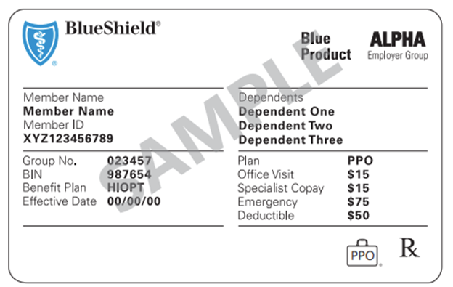
How the BlueCard Program Works
An Out-of-Area (OOA) Blue member with Blue Cross and Blue Shield of Mississippi (BCBSMS) benefits lives in Louisiana and visits a Louisiana Blue Preferred Care PPO network provider.
Louisiana provider recognizes the logo on the member ID card and verifies membership and coverage using iLinkBlue or by calling BlueCard Eligibility.
BlueCard Eligibility
1-800-676-BLUE (1-800-676-2583)
www.lablue.com/ilinkblue

Slide 7
How the BlueCard Program Works
Louisiana provider submits claim to Louisiana Blue.
OOA
Louisiana Blue submits electronic transaction to BCBSMS. BCBSMS applies the member’s benefits (medical policy, authorization requirements, coverage limitations, etc.).
OOA
BCBSMS routes the claim back to Louisiana Blue for provider reimbursement.
Louisiana Blue issues remittance and payment to our provider. BCBSMS issues an explanation of benefits (EOB) to the member.
Some ancillary services have different filing rules. Please reference the “Ancillary Claims” section of The BlueCard Program Provider Manual found online at www.lablue.com/providers >Resources >Manuals.

Slide 8
How the BlueCard Program Works
Always verify a member’s benefits with the member’s plan. BlueCard Eligibility, 1-800-676-BLUE has information about:
Eligibility and coverage
Dependents
Deductibles
Copayments
Coinsurance
Benefit maximums
Referral and authorization information
Other benefit information
Admitting hospital or provider must request authorization from the home Plan for inpatient admissions. Claims without prior authorization will be rejected.
Collect any member cost share for services.

Slide 9
Identifying Members

Slide 10
BlueCard Products
BlueCard excludes:
Stand-alone dental
Vision delivered through an intermediary model
Self-administered prescription drugs delivered through an intermediary model
Medicaid and SCHIP that is part of the Medicaid program
Federal Employee Program (FEP)*
Medicare Advantage**
*FEP members have the letter “R” in front of their member number. Please follow your FEP billing guidelines for these contracts.
**Medicare Advantage is a separate program from BlueCard and delivered through its own centrally administered platform. However, since you might see members of other BCBS Plans who have Medicare Advantage coverage, there is a section on Medicare Advantage claims processing in The BlueCard Program Provider Manual.

Slide 11
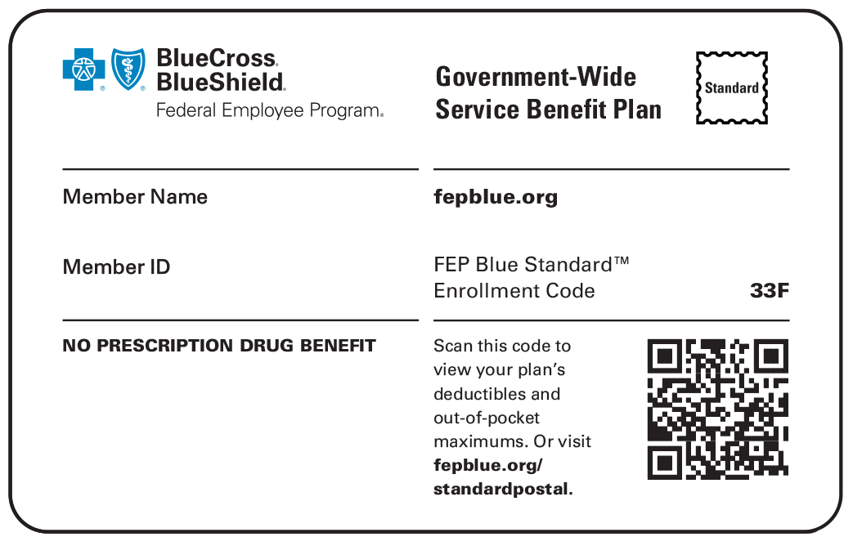
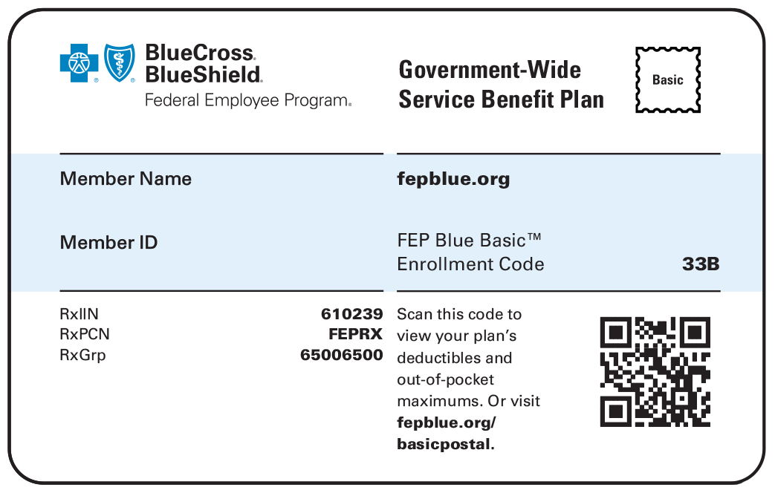
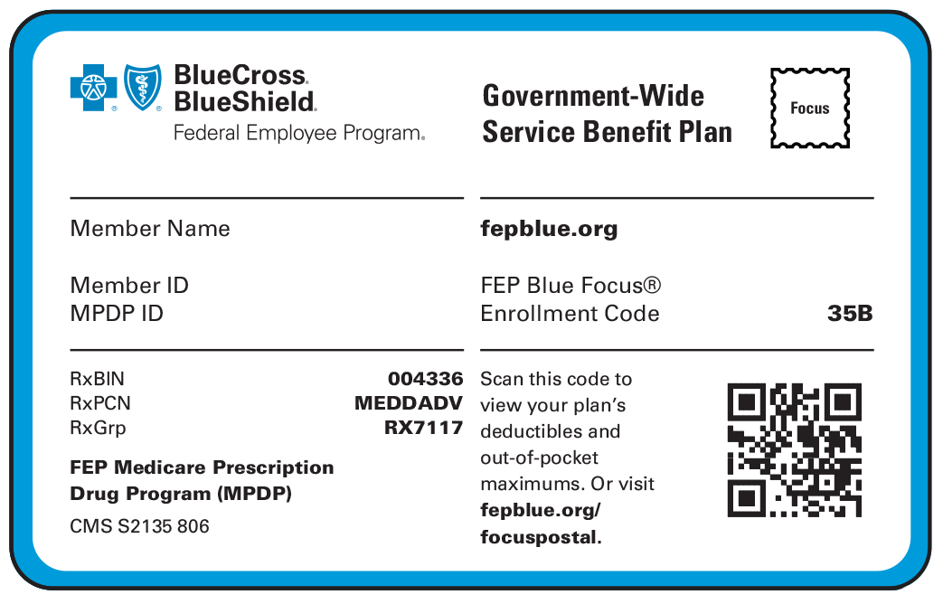
Identifying FEP Members
ID cards for FEP members do not display a three-character prefix. Rather, all FEP member ID numbers begin with the letter “R,” as highlighted on the sample ID cards below.
FEP members are excluded from the BlueCard Program.
SAMPLE
SAMPLE
SAMPLE
BLUE SUBSCRIBER
BLUE SUBSCRIBER
BLUE SUBSCRIBER
R00000000
R00000000
R00000000

Slide 12
Identifying BlueCard Members
The main identifiers for BlueCard members are the prefix and suitcase logo.
The three-character prefix at the beginning of the member ID number is the key element used to identify and correctly route out-of-area claims.
Helpful tips:
Regularly obtain new copies of the member ID card (front and back).
Verify the member’s eligibility through iLinkBlue or by calling BlueCard Eligibility at 1-800-676-2583.
Carefully determine the member’s financial responsibility before processing payment.
If the member is using an HSA or HRA debit card, be sure to verify the member’s cost share before processing payment.

Slide 13
ID Card Prefixes
The majority of Blue-branded ID cards display a three-character prefix in the first three positions of the subscriber’s ID number.
Exceptions include:
Stand-alone vision and pharmacy when delivered through an intermediary model*
Stand-alone dental products*
Federal Employee Program (FEP) – has the letter “R” in front of the ID number*
*Follow instructions printed on these ID cards for how to verify eligibility, submit claims and for contact information.
The prefix is critical for any inquiries regarding the member, including eligibility and benefits, and is necessary for proper claim filing.
A1C1234567 A1C1234H567 A1CD1234H567 A1CD1234H56789012
When filing the claim, always enter the ID number exactly as it appears on the member’s card, inclusive of the prefix, and include this complete identification number on any documents pertaining to services to ensure accurate handling by the Blue Plan. If the card presented has no prefix, follow the instructions on the back of the card for claims handling.

Slide 14
Identifying BlueCard Member ID Cards
The PPO suitcase indicates the member is enrolled in a Blue Plan’s PPO or EPO product.
The PPOB in a suitcase indicates the member has access to the exchange PPO network, referred to as BlueCard PPO basic.
The empty suitcase logo indicates the member is enrolled in a Blue Plan’s traditional, HMO, POS or limited benefits product.
The BlueHPN suitcase logo indicates the member is enrolled in a Blue High Performance Network® (BlueHPN®) product.
Some member ID cards do not have a prefix or suitcase logo, which may indicate that claims are handled outside of the BlueCard Program. Please look for instructions or a telephone number on the back of the card for how to file claims.
Notes:
in LA it is based on the Blue Connect network and it is an EPO

Slide 15
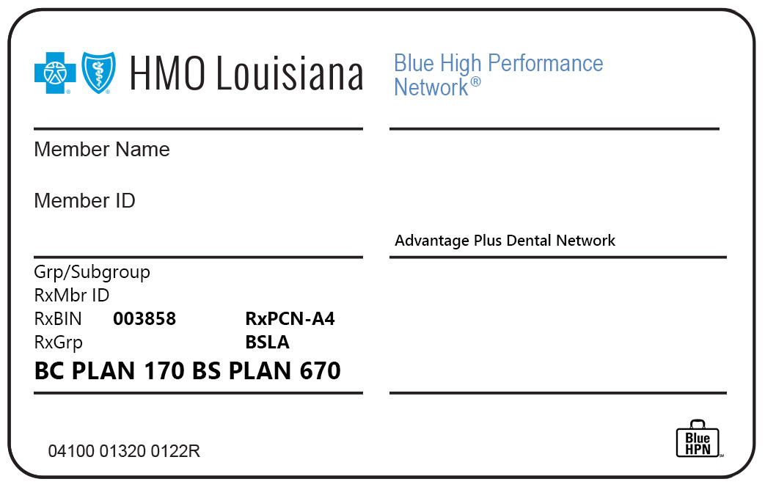
Identifying BlueHPN Member ID Cards
BlueHPN is an Exclusive Provider Organization (EPO). This means benefits are only covered for care by in-network providers.
It is important to note that for non-BlueHPN providers, benefits for services incurred are limited to emergent care within BlueHPN product areas, and to urgent and emergent care outside of BlueHPN product areas.
Benefit limitations are included on the back of the BlueHPN member ID card.
BlueHPN members are recognizable by:
The Blue High Performance Network name on the front of the member ID card.
The BlueHPN in a suitcase logo in the bottom right-hand corner of the member ID card.
SAMPLE
Notes:
in LA it is based on the Blue Connect network and it is an EPO

Slide 16
Medicare Advantage Members from Other Blue Plans
Medicare Advantage (MA) is the program alternative to standard Medicare Part A and Part B fee-for-service coverage, generally referred to as “traditional Medicare.”
All Medicare Advantage Blue Plans must offer beneficiaries at least the standard Medicare Part A and B benefits, but many offer additional covered services.
Medicare Advantage organizations may also offer a Special Needs Plan (SNP).
MA Blue Plans may allow in- and out-of-network benefits, depending on the type of product selected.
To verify eligibility and/or benefits for MA members from other Blue Plans, call BlueCard Eligibility, or submit an inquiry through iLinkBlue.
Louisiana Blue offers two MA products statewide
Blue Advantage (HMO)
Blue Advantage (PPO)
Benefit and eligibility for these products are handled through the Blue Advantage Provider Portal (www.lablue.com/ilinkblue >Blue Advantage). This tool is not used for BlueCard MA members.

Slide 17
Medicare Advantage PPO Network Sharing
All Blue Plans that offer a MA PPO Plan participate in reciprocal network sharing. This allows Blue MA PPO members to obtain in-network benefits in the service area of any other Blue MA PPO Plan as long as the member sees a contracted MA PPO provider.
If you are a participating provider in our MA PPO network…
If you are NOT a participating provider in our MA PPO network…
If your practice is closed to new members…
you should provide the same access to care for Blue MA PPO members as you do for our members. Services will be reimbursed in accordance with your Louisiana Blue MA PPO allowable charges. The Blue MA PPO member’s in-network benefits will apply.
but do accept Medicare and you see Blue MA PPO members; you will be reimbursed for covered services at the Medicare allowed amount based on where the services were rendered and under the member’s out-of-network benefits. For urgent or emergent care, you will be reimbursed at the member’s in-network benefit level.
you do not have to provide care for Blue MA PPO out-of-area members. The same contractual arrangements apply to these out-of-area network sharing members.
Blue MA PPO members are recognizable by the “MA” suitcase on the member ID card.

Slide 18
Using iLinkBlue

Slide 19
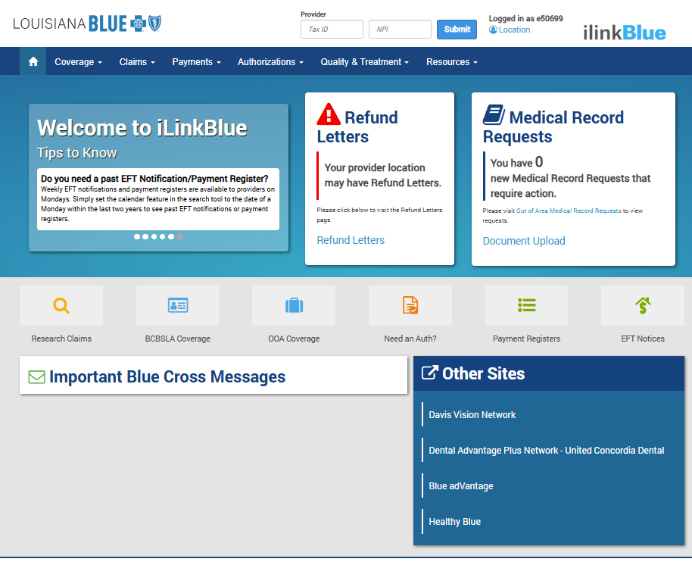
Navigating iLinkBlue
Top Navigation
The top navigation streamlines iLinkBlue functions under six menus. When you click a menu option, a sub-menu appears that includes relevant features.
Refund Letters
Providers now have a shortcut to check/search for Refund Request Letters.
10
Medical Record Requests
Providers receive an alert when they have Out of Area Medical Record Requests for BlueCard members. To view these requests, click the “Out of Area Medical Record Requests” link on the alert. This does not include medical record requests for Louisiana Blue members. To upload medical records and other documents, click the “Document Upload” link.
Quick Links
This area contains shortcuts to the six most-used iLinkBlue functions.
Message Board
Contains up-to-the-minute posts for upcoming events, new features, system outages, holiday notices and other important bulletins.
Other Sites
Includes quick access to other sites providers might need to access.

Slide 20
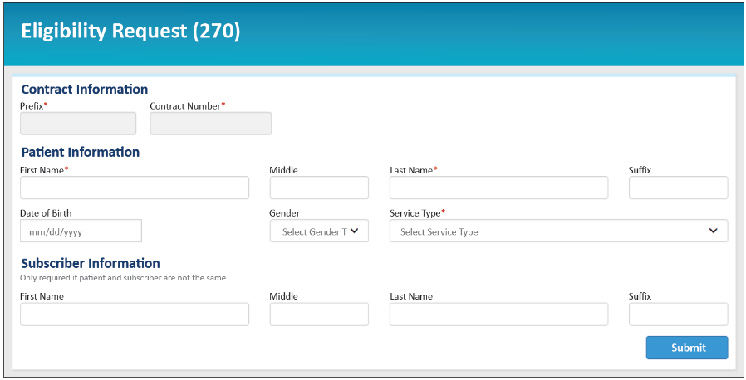
iLinkBlue: Coverage Submitting Eligibility Requests
Use this section to research coverage information for a BlueCard member (insured through a Blue Plan other than Louisiana Blue).
Submit Eligibility Request (270) – Click on this link to submit an electronic eligibility inquiry to the out-of-area member’s Blue Plan. Enter the member’s prefix (the first three characters of the member ID number), the contract number and then click “Submit.”
View Eligibility Response (271) – Click on this link to access the electronic response from the member’s Blue Plan (shown above). Though not immediate, out-of-area responses are transmitted back usually within less than a minute if the Plan provides one. Eligibility responses are retained for 21 days.

Slide 21
iLinkBlue: Coverage Submitting Eligibility Requests (270)
To ensure proper benefits are returned when submitting Eligibility Requests (270), use the drop-down to select the most appropriate service type from the following code list:
1 Medical Care
2 Surgical
3 Consultation
4 Diagnostic X-Ray
5 Diagnostic Lab
6 Radiation Therapy
7 Anesthesia
8 Surgical Assistance
9 Other Medical
10 Blood Charges
11 Used Durable Medical Equipment
12 Durable Medical Equipment Purchase
13 Ambulatory Service Center Facility
14 Renal Supplies in the Home
15 Alternate Method Dialysis
16 Chronic Renal Disease (CRD) Equipment
17 Pre-Admission Testing
18 Durable Medical Equipment Rental
19 Pneumonia Vaccine
20 Second Surgical Opinion
21 Third Surgical Opinion
22 Social Work
23 Diagnostic Dental
24 Periodontics
25 Restorative
26 Endodontic
27 Maxillofacial Prosthetics
28 Adjunctive Dental Services
30 Health Benefit Plan Coverage
32 Plan Waiting Period
33 Chiropractic
34 Chiropractic Office Visits
35 Dental Care
36 Dental Crowns
37 Dental Accident
38 Orthodontics
39 Prosthodontics
40 Oral Surgery
41 Routine (Preventive) Dental
42 Home Health Care
43 Home Health Prescriptions19
44 Home Health Visits
45 Hospice
46 Respite Care
47 Hospital
48 Hospital - Inpatient
49 Hospital - Room and Board
50 Hospital - Outpatient
51 Hospital - Emergency Accident
52 Hospital - Emergency Medical
53 Hospital - Ambulatory Surgical
54 Long Term Care
55 Major Medical
56 Medically Related Transportation
57 Air Transportation
58 Cabulance
59 Licensed Ambulance
60 General Benefits
61 In-vitro Fertilization
62 MRI/CAT Scan
63 Donor Procedures
64 Acupuncture
65 Newborn Care
66 Pathology
67 Smoking Cessation
68 Well Baby Care
69 Maternity
70 Transplants
71 Audiology Exam
72 Inhalation Therapy
73 Diagnostic Medical
74 Private Duty Nursing
75 Prosthetic Device
76 Dialysis
77 Otological Exam
78 Chemotherapy
79 Allergy Testing
80 Immunizations
81 Routine Physical
82 Family Planning
83 Infertility
84 Abortion
85 AIDS
86 Emergency Services
87 Cancer
88 Pharmacy
89 Free Standing Prescription Drug
90 Mail Order Prescription Drug
91 Brand Name Prescription Drug
92 Generic Prescription Drug
93 Podiatry
94 Podiatry - Office Visits
95 Podiatry - Nursing Home Visits
96 Professional (Physician)
97 Anesthesiologist
98 Professional (Physician) Visit - Office
99 Professional (Physician) Visit - Inpatient
A0 Professional (Physician) Visit - Outpatient
A1 Professional (Physician) Visit - Nursing Home
A2 Professional (Physician) Visit - Skilled Nursing Facility
A3 Professional (Physician) Visit - Home
A4 Psychiatric
A5 Psychiatric - Room and Board
A9 Rehabilitation
AA Rehabilitation - Room and Board
AB Rehabilitation - Inpatient
AC Rehabilitation - Outpatient
AD Occupational Therapy
AE Physical Medicine
AF Speech Therapy
AG Skilled Nursing Care
AH Skilled Nursing Care - Room and Board
AI Substance Abuse
AJ Alcoholism
AK Drug Addiction
AL Vision (Optometry)
AM Frames
AN Routine Exam
AO Lenses
AQ Nonmedically Necessary Physical
AR Experimental Drug Therapy
BA Independent Medical Evaluation
BB Partial Hospitalization (Psychiatric)
BC Day Care (Psychiatric)
BD Cognitive Therapy
BE Massage Therapy
BF Pulmonary Rehabilitation
BG Cardiac Rehabilitation
BH Pediatric
BI Nursery
BJ Skin
BK Orthopedic
BL Cardiac
BM Lymphatic
BN Gastrointestinal
BP Endocrine
BQ Neurology
BR Eye
BS Invasive Procedures
BT Gynecological
BU Obstetrical
BV Obstetrical/Gynecological
BY Physician Visit – Office: Sick
BZ Physician Visit – Office: Well
CE MH Provider – Inpatient
CF MH Provider – Outpatient
CG MH Provider Facility – Inpatient
CH MH Provider Facility – Outpatient
CI Substance Abuse Facility – Inpatient
CJ Substance Abuse Facility – Outpatient
CK Screening X-ray
CL Screening Laboratory
CM Mammogram, HR Patient
CN Mammogram, LR Patient
CO Flu Vaccination
DM Durable Medical Equipment
MH Mental Health
PT Physical Therapy
UC Urgent Care
The full listing can also be found in the iLinkBlue User Guide on our Provider page at www.lablue.com/providers >Resources >Manuals.

Slide 22
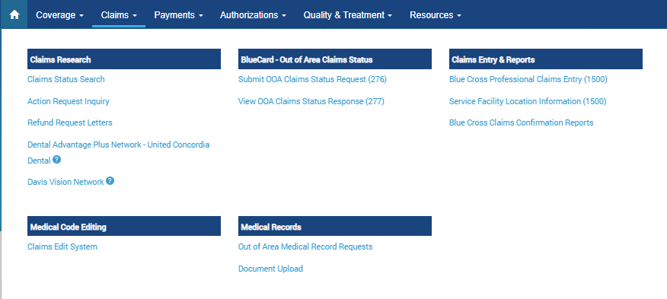
iLinkBlue: Claims Claims Status Search
Claims Status Search – research paid/rejected or pended claims. You can also search by claim number.
Research BCBSLA, FEP and BlueCard - Out of Area claims.
Notes:
To view all claims for a member... On the selected status tab, leave the “From” date of service field blank. The “To” date of service field will default to the current date.
identify the BlueCard out of area to find out of state Louisiana Blue claims

Slide 23
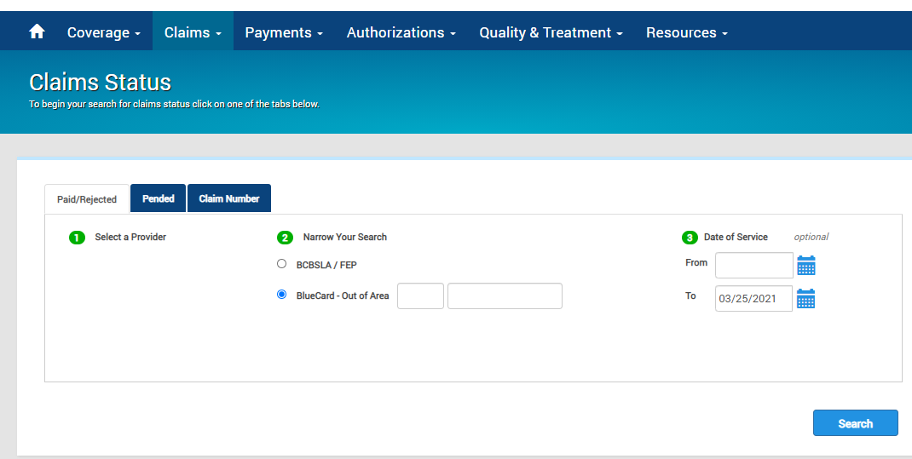
iLinkBlue: Claims BlueCard – Out of Area Claims Status
Paid/Reject Search

Slide 24
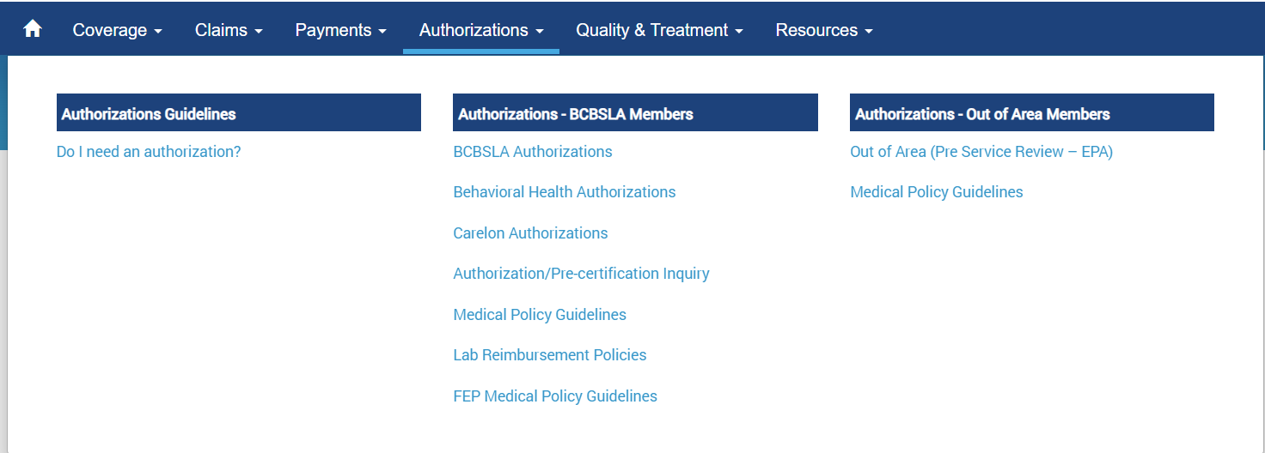
iLinkBlue: Obtaining Authorizations
Out of Area (Pre-Service Review - EPA) – is designed to allow Louisiana Blue providers access to pre-service information offered by other Blue Plans.
Enter the member ID three-character prefix.
This will route you to the member’s Blue Plan.
If the member’s plan offers functionality, you will be able to enter the authorization request.
If the member’s plan does not offer functionality, instructions on how to obtain the authorization request will be available.
Notes:
whenever you are going OOS, you are at that plan's mercy. there may not be authorization information available.

Slide 25
iLinkBlue: Authorization and Billing Guidelines
Step 1: Log into iLinkBlue and click “Authorization Guidelines – Do I need an authorization?” under Authorizations.
Step 2: Enter the member ID prefix.

Slide 26
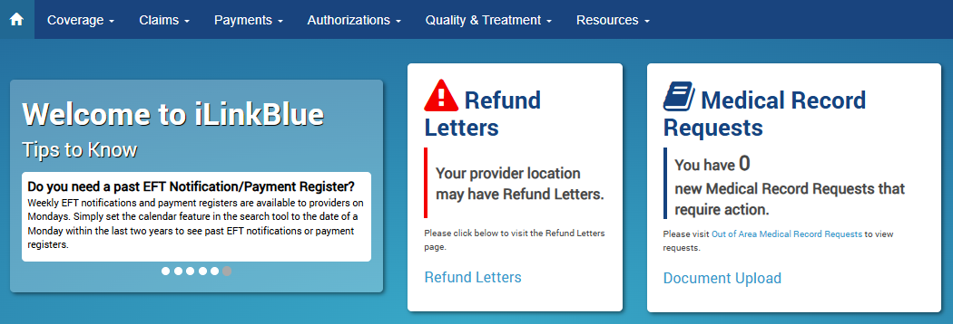
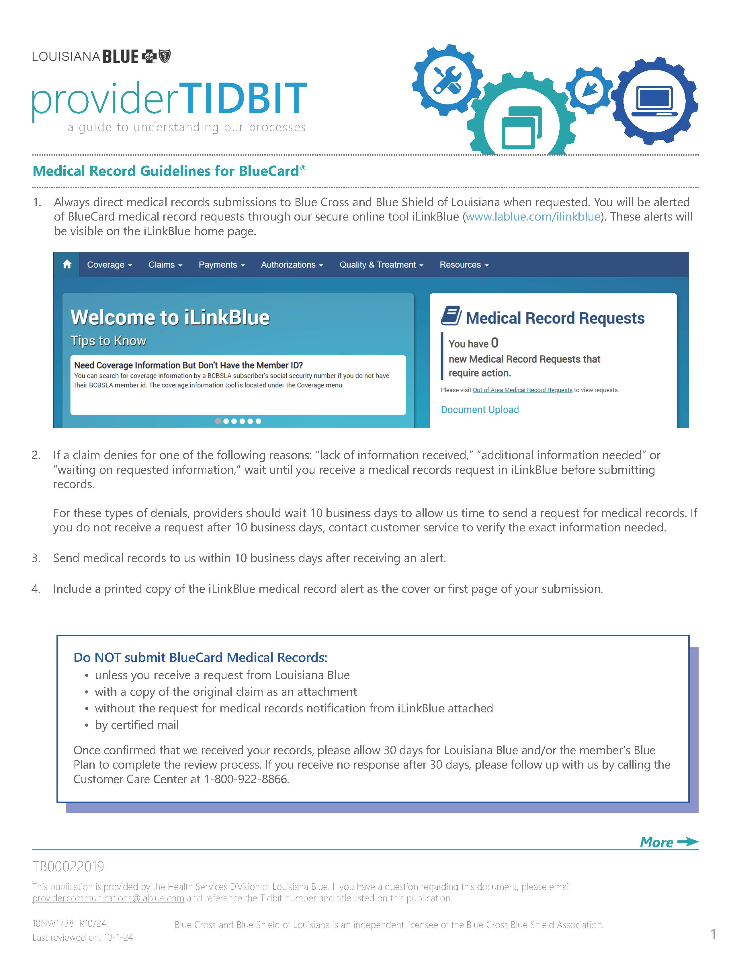
Submitting BlueCard Medical Records
Always direct medical records submissions to Louisiana Blue when requested. You will be alerted of BlueCard medical record requests through our secure online tool iLinkBlue (www.lablue.com/ilinkblue). These alerts will be visible on the iLinkBlue home page. Medical Record Requests will no longer be sent hardcopy.
If a claim denies for one of the following reasons: “lack of information received,” “additional information needed” or “waiting on requested information,” wait until you receive a medical records request in iLinkBlue before submitting records.
For these types of denials, providers should wait 10 business days to allow us time to send a request for medical records. If you do not receive a request after 10 business days, contact customer service to verify the exact information needed.
Send medical records to us within 10 business days after receiving an alert.
Include a printed copy of the iLinkBlue medical record alert as the cover or first page of your submission.
10
More information on Medical Records Guidelines for BlueCard can be found online at www.lablue.com/providers >Resources >Tidbits.
Notes:
this slide applies to blue card only - Commercial and MA
Since the providers belong to Louisiana Blue, the requests come through us. Then we send to the member’s home plan

Slide 27
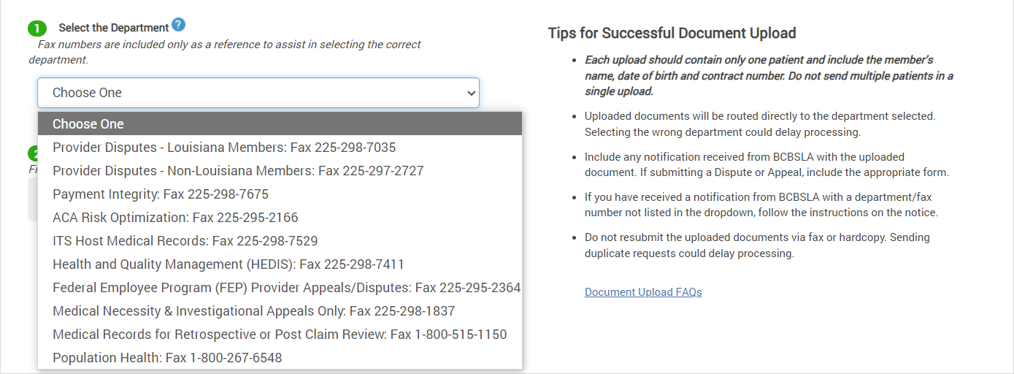
Document Upload
Louisiana Blue accepts document uploads for:
Provider Disputes
Payment Integrity
ACA Risk Optimization
ITS Host Medical Records
Health and Quality Management (HEDIS®)
Federal Employee Program (FEP) Appeals
Medical Necessity & Investigational Appeals Only
Medical Records for Retrospective or Post Claim Review
Population Health
Document Upload - upload documents that would otherwise be faxed, emailed or mailed.
Once Louisiana Blue receives the uploaded document, a confirmation message will display, “The uploaded file was successfully received and sent to XXX Department at HHMMSS am/pm, MM/DD/YY.”
Notes:
While the link to the application is under the medical records section of iLinkBlue, the application allows for other document uploads, based on the department selected.
Upload limit 10MB. Files that are over 10MB in size will not be accepted for upload. Documents that exceed this limit will need to be faxed or mailed to Louisiana Blue.
Why are fax numbers next to the department name in the drop-down box?
The drop-down includes fax numbers as a reference to ensure that you are choosing the correct department when uploading documents. The fax numbers are also listed on your request letter or appropriate form.
Do not send a fax or hardcopy request in addition to requests submitted through the document upload application. Also sending your request via fax, email or mail will result in a duplicate request. This could delay the processing of your uploaded request.

Slide 28
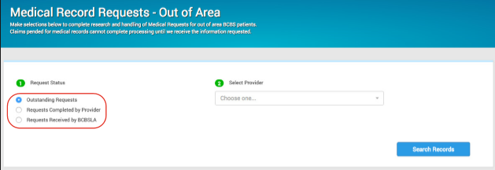
Submitting BlueCard Medical Records
BlueCard Medical Records Requests on iLinkBlue
View medical records requests for your BlueCard patients in iLinkBlue by clicking the Out of Area Medical Record Requests link on the message board alert.
You can also access requests by clicking on Claims >Medical Records >Out of Area Medical Record Requests.
Use the Medical Record Requests section to research Outstanding Requests, Requests Completed By Provider and Requests Received by Louisiana Blue.
You will receive confirmation once your files are uploaded.
Please allow 30 days for the review process.
If the claim has not been processed after 30 days, please follow up with the Customer Care Center at 1-800-922-8866.
Notes:
Do NOT submit BlueCard Medical Records:
unless you receive a request from Louisiana Blue
with a copy of the original claim as an attachment
without the request for medical records notification from iLinkBlue attached
by certified mail
when you upload your medical records, you will get a confirmation. or if your claim has not been processed after 30 days, then you will need to call CSC.

Slide 29
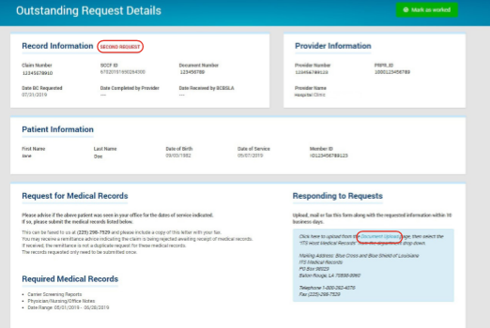
Submitting BlueCard Medical Records
Second requests will display in red under Outstanding Requests search results. A second request displays when records have been requested more than once with no response.
After selecting a request from the search results, the Outstanding Request Details screen displays. This screen shows a summary of the medical record request including the claim, patient and provider information.
The Outstanding Request Details screen displays second requests in red to the right of the Record Information.
After submitting requested medical records to Louisiana Blue, click the Mark as worked button.
This moves the request to the Completed by Provider section. The request will no longer appear on the Outstanding Requests Details screen.
You have the option to submit medical records through iLinkBlue by clicking on “Document Upload.” This accesses an application that allows you to upload documents directly into iLinkBlue.
Notes:
When medical records are requested in iLinkBlue, make sure your office or facility has a designated person to check and review the requests or your claim will never get processed. Also, If you have a patient they are requesting records on, but perhaps did not see the patient on that date of service, please be sure to first print out the request and write “patient not seen on this date of service” and upload it to the portal. This way, it will not remain a pending request. In all cases, once the medical records have been uploaded, please remember to “mark as worked” so that the request will go away.

Slide 30
Claims

Slide 31
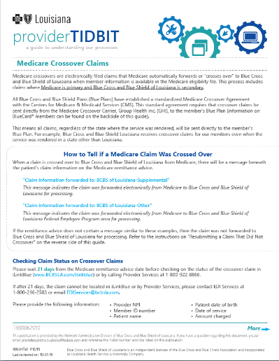
Medicare Crossover Claims
Medicare crossovers are electronically filed claims that Medicare automatically forwards or “crosses over” to the member’s Blue Plan when information is available in the Medicare eligibility file.
When a Medicare claim is crossed over to an out-of-state Blue Plan, the Medicare remittance advice will have a message beneath the patient’s claim information similar to:
“Claim information forwarded to: BCBS of Texas”
If the remittance advice does not contain a message similar to this example, then the claim was not forwarded electronically to the member’s Blue Plan for processing. The provider must then file the claim, along with a copy of the Medicare Remittance Advice, with the member’s Blue Plan (as listed on the member ID card).
If Medicare has forwarded the claim to the member’s Blue Plan, please allow 25-30 days from the Medicare remittance advice date before contacting the member’s Blue Plan.
For more information, refer to the “Medicare Crossover Claims” Tidbit online at www.lablue.com/providers >Resources >Tidbits.

Slide 32
Ambulance Claims
Ground Service
All ground ambulance claims must include the point-of-pick-up ZIP code.
Air Service
All air ambulance claims must include the 5-digit ZIP code of the point-of-pick-up. Claims that do not include the point-of-pick-up ZIP code on the claim will be denied for insufficient information.
Where to file air ambulance claims:
If the pick-up location is in Louisiana, the claim should be filed directly to Louisiana Blue.
If the pick-up location ZIP code is outside of Louisiana, the claim should be filed to the local Blue Plan that covers the area of pick-up.
If the pick-up location is outside the US, the claim must be filed to the Blue Cross Blue Shield Global® Core (www.bcbsglobalcore.com).
Notes:
Ambulance Claims. section 5.4 of the billing guidelines under professional manual. and section 5.3 of the facility manual.

Slide 33
Filing Claims Submitting Claims for BlueCard Members
Submit BlueCard claims directly to Louisiana Blue.
Once Louisiana Blue receives the claim, we will electronically route the claim to the member’s Blue Plan. The member’s plan then applies benefits, approves payment, routes the claim back to Louisiana Blue. Louisiana Blue will then reimburse you.
Filing Claims with Your National Provider Identifier (NPI) – Your NPI is used for claims processing and internal reporting. Claim payments are reported to the Internal Revenue Service (IRS) using your Tax ID Number (TIN).
Referring Physician NPIs – Referring physician NPIs are required on all applicable claims filed with Louisiana Blue and HMO Louisiana.

Slide 34
Ancillary and Remote Providers
Ancillary providers are independent clinical laboratories, durable/home medical equipment (DME/HME) and supply providers and specialty pharmacies located within the Louisiana Blue service area.
Remote providers are those located outside of the service area and are contracted to act as a local provider.
If a remote provider contract is in place with the local plan, the claim must be filed to the local plan and would be considered a participating provider claim.
If a remote provider contract is not in place with the local plan, the claim must be filed to the local plan and would be considered a nonparticipating provider claim.
Notes:
More information about ancillary claims filing can be found in the BlueCard Provider Manual on page 2-3 and 2-4.
If referring Doctor’s provider address is in Texas, the lab address is in Mississippi and the patient’s coverage is BCBS Arkansas:
The lab claim will be filed where the patient was seen: BCBS of Texas
Services will be out-of-network unless the lab in Mississippi has a contract with BCBSTX
It is a BCBA mandate for the referring doctor and the lab claims to be filed to the SAME state.

Slide 35
Ancillary Claims Examples
Provider Type | Where to File | Example
Lab | File the claim to the Plan in which state the specimen was drawn. Where the specimen was drawn will be determined by which state the referring provider is located. | Blood is drawn in lab located in Alabama. Blood analysis is done in South Carolina. File to: BlueCross BlueShield of Alabama. You must file claims for the analysis of a lab to the Plan in which state the specimen was drawn.
DME | File the claim to the Plan in which state the equipment was shipped to or purchased in a retail store. | Wheelchair is purchased at a retail store in South Carolina. File to: BlueCross BlueShield of South Carolina.
Specialty Pharmacy | File the claim to the Plan in the state where the ordering provider is located. | Patient is seen by a physician in Ohio who orders a specialty pharmacy injectable for the patient. Patient will receive the injections in South Carolina where the member lives for six months of the year. File to: Blue Cross Blue Shield of Ohio.

Slide 36
Split Claims
When a claim is billed that meets the following criteria, the provider should split the charges into two claims:
When the claim is outpatient, and the professional claim spans a calendar year.
When participating and nonparticipating providers are billed on the claim.
When the claim is from a single provider whose status changes from participating to non-participating or from non-participating to participating during the span of services billed on the claim.
When there is membership coverage changes, the claim must be split at the date of coverage change.
When a claim is received that includes both surprise bill services (as specified under the No Surprises Act and its accompanying regulations) and those that are not considered surprise bill services. For more information about the No Surprises Act, visit www.cms.gov/nosurprises.
For hospitals, when a mother and newborn claim includes a discharge date for the baby that is after the mother’s discharge date.
For hospitals, when a mother and newborn claim includes NICU admission, the claim must be split on the date the baby is admitted to the NICU.
Depending on plan processes, the Blue Plan may also require the claim to be split if multiple professional providers are billed on the same claim.
More information can be found in our BlueCard Manual online at www.lablue.com/providers >Resources >Manuals.
Notes:
Split claims : remember we have the Blue Card Manual on our website www.lablue.com/providers >Resources >Manuals.
This image shows the 2025 manual. The 2025 manual is online now but 2024 is also there. It is recommended to look at both to understand any changes coming 1/1/25.

Slide 37
Reimbursement Claims Payment
Guidelines for BlueCard claims payment:
If you have not received payment for a claim, do not resubmit the claim because it will deny as a duplicate.
Check the Not Accepted report on iLinkBlue under Claims, then Louisiana Blue Claims Confirmation Reports.
Check claim status on iLinkBlue.
If you have further questions about your claim, you may submit an Action Request.
Or call the Customer Care Center at 1-800-922-8866.
For paid/rejected claims, you must provide the amount paid or ineligible amount, code and claim number.
For pended claims, you must provide the claim number and pended reason.
www.lablue.com/ilinkblue
Note: In some cases, a member’s Blue Plan may pend a claim because medical review or additional information is necessary. Louisiana Blue may either ask you for the information or give the member’s Plan permission to contact you directly.

Slide 38
Reimbursement Coordination of Benefits
Coordination of Benefits (COB) ensures members receive full benefits from their health benefit plans and prevents double payment for services when a member has coverage from two or more sources.
Please use the following guidelines when submitting COB claims:
If Louisiana Blue or any other Blue Plan is the primary payor, submit the other carrier’s name and address with the claim to Louisiana Blue.
If a non-Blue health plan is primary and Louisiana Blue or any other Blue Plan is secondary, submit the claim to Louisiana Blue only after receiving payment and explanation of payment from the primary payor.
Carefully review the payment information from all payors involved on the remittance advice(s) before balance billing the patient for any potential liability.
Coordination of Benefits Questionnaire form – This will help you and your patients avoid potential claim issues while streamlining claims processing and reducing the number of denials related to COB. This form is available online at www.lablue.com/providers >Resources >Forms.
Notes:
Remember: if a member has two Louisiana Blue plans, both will need to be filed to Louisiana Blue. For instance: one OOS and one with LA or even both for OOS, both plans have to be listed on the claim form. The claim will not crossover to the secondary plan, you will need to file it again to Louisiana Blue

Slide 39
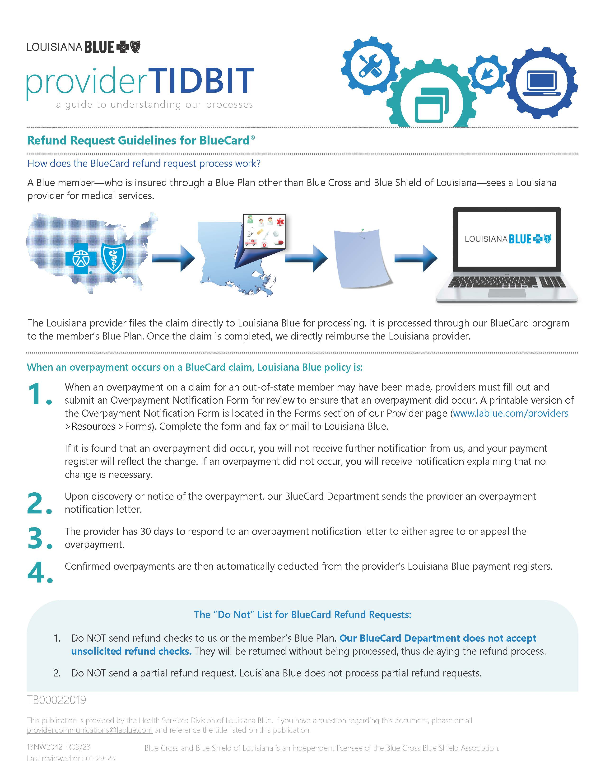
Refund Request Guidelines
When an overpayment occurs on a BlueCard claim, Louisiana Blue policy is:
When the provider suspects an overpayment on a BlueCard claim, they may fill out and submit an Overpayment Notification Form notifying us of the overpayment after 10 business days of receipt of payment. The Overpayment Notification Form is available at www.lablue.com/providers >Resources >Forms.
Providers may also notify us of an overpayment via the action request (AR) system available through iLinkBlue (www.lablue.com/ilinkblue), under the “Claims” tab. Click “Claims Status Search” then the orange “AR” button to start the request. Using iLinkBlue is quick, easy and reduces the wait time for processing the overpayment notification.
Upon discovery or notice of the overpayment, our BlueCard Department sends the provider an overpayment notification letter.
The provider has 30 days to respond to an overpayment notification letter to either agree to or appeal the overpayment.
Confirmed overpayments are then automatically deducted from the provider’s Louisiana Blue payment registers.
Refund Request Guidelines for BlueCard Tidbit can be found online at www.lablue.com/providers >Resources >Forms.
Notes:
Refund request guidelines: for LA, the provider can send us a check or opt to have it recouped on a future ERA but for OOS, they have to notify us and we will recoup from future ERA.

Slide 40
Resolving Claims Issues Have an issue with a claim? We are here to help!
Depending on the type of claim issue, there are multiple ways to submit claims reviews:
Submit Action Requests through iLinkBlue
Provider Disputes
Medical Appeals
Administrative Appeals & Grievances
Submitting an Action Request is a great option for getting a quick and accurate resolution for your claims issues. Action Requests:
Reduce the time it takes for providers to receive a response from Louisiana Blue.
Allow providers to see responses directly from the adjustments team after review.
Allow providers to submit additional questions once they have reviewed the AR response.

Slide 41
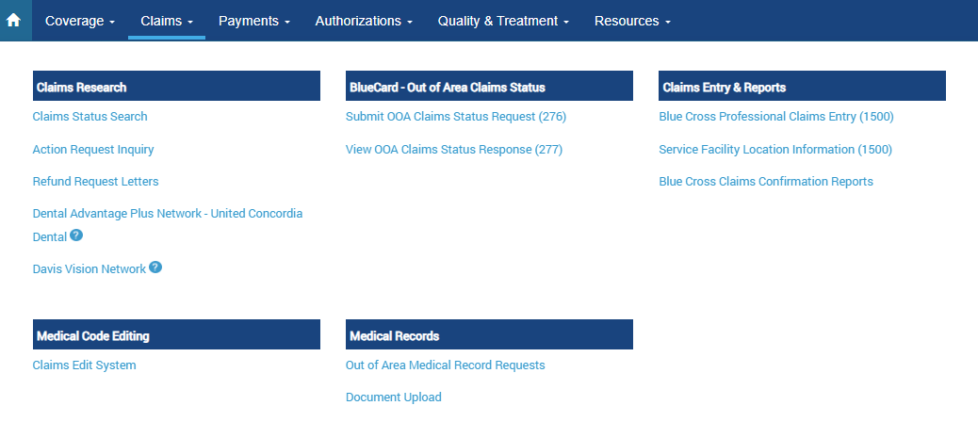
Submitting Action Requests
Action Requests allow you to electronically communicate with Louisiana Blue when you have questions or concerns about a claim.
Common reasons to submit an Action Request
Claims
Questioning non covered charges or specific denial
No record of membership (make sure to check member’s ID)
Denied as duplicate (Ex. Medicare crossover)
Coordination of benefits
Refund request
Action Requests do not allow you to submit documentation regarding your claims review.
Use Claims Edit System tool for bundled codes instead of Action Requests.

Slide 42
Submitting Action Requests
To submit an Action Request, choose the Claims menu option in iLinkBlue (www.lablue.com/ilinkblue), then choose the Claim Status Search application. On each claim, there is an Action Request button to have the claim reviewed. The electronic form will prepopulate with information on the specific claim.
on the Paid/Rejected Claims Results screen
and
on the Pended Claims Results screen
on the Claims Detail screen
Notes:
If the claim has more than one line, you only need to do 1 Action Request.

Slide 43
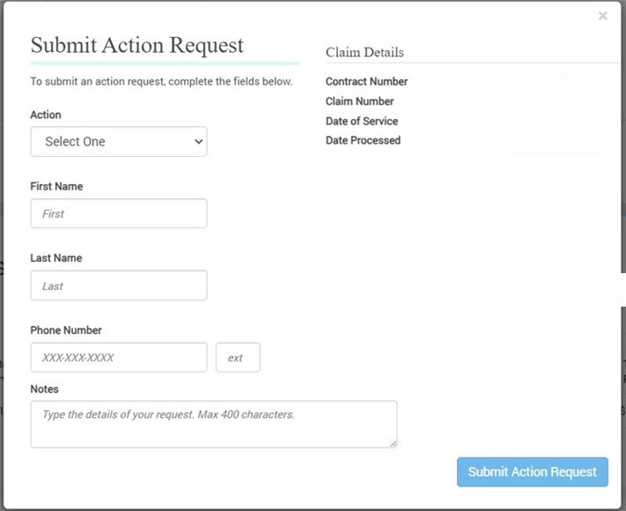
Submitting Action Requests
When submitting an Action Request:
Include your contact information.
Be specific and detailed but be mindful of character limit.
Allow 10-15 working days for a response to each request.
Check in Action Request Inquiry for a response.
Don’t submit an Action Request immediately following document upload.
Note: Please only submit one Action Request per claim; not one Action Request per line item of the claim.
Notes:
There is nothing that will alert you and you have to check the status. They are based on priority and if you submit it on monday, you should see it by friday.

Slide 44
Provider Disputes & Appeals
Sometimes it may be necessary for a provider to dispute or appeal a claim.
Provider Disputes
Involves a denial that affects the provider's reimbursement.
Medical Appeals
Involves a denial or partial denial based on:
Medical necessity, appropriateness, healthcare setting, level of care or effectiveness.
Determined to be experimental or investigational.
Administrative Appeals & Grievances
Claims issue due to the member’s contract benefits, limitations, exclusions or cost share.
When there is a grievance.

Slide 45
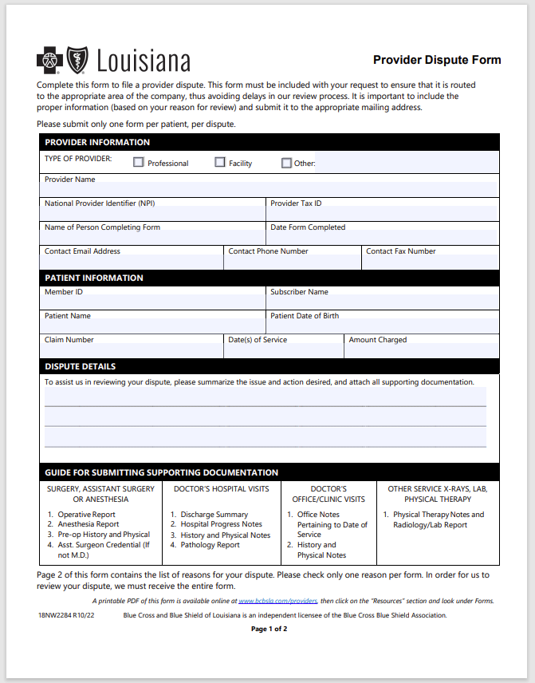
Provider Disputes
Network providers disputing claims for BlueCard® members (out-of-state policies) should submit via:
Online via iLinkBlue (www.lablue.com/ilinkblue). Under “Claims,” click “Document Upload,” then “Provider Disputes-Non-Louisiana Members” in the drop-down menu.
Fax: (225) 297-2727
Hardcopy: P.O. Box 98029
Baton Rouge, LA 70809
A provider dispute is different than an appeal or grievance. Provider disputes are defined as written requests from our participating network providers (In Network Providers ONLY) questioning (or disputing) their allowable charge of a processed claim. Disputes could involve the following:
Reimbursement concerns
Allowable disputes (must include breakdown, fee schedule)
Bundling issues (must always have medical records attached)
Authorization issues
Penalties where the provider is liable for the amount
Failed to obtain authorization denials (reason auth not obtained)
Refund disputes
Maximum daily benefit denials
Timely filing denials
Form is available online at www.lablue.com/providers >Resources >Forms.
Notes:
Strongly recommend uploading to iLinkBlue. The fax number for the oos will still go to the same place as the document upload. you will get a confirmation.
the Provider Dispute form is only if they cannot do an Action Request or if they need to send us additional information such as documentation, etc. to support their dispute.

Slide 46
Online Resources

Slide 47
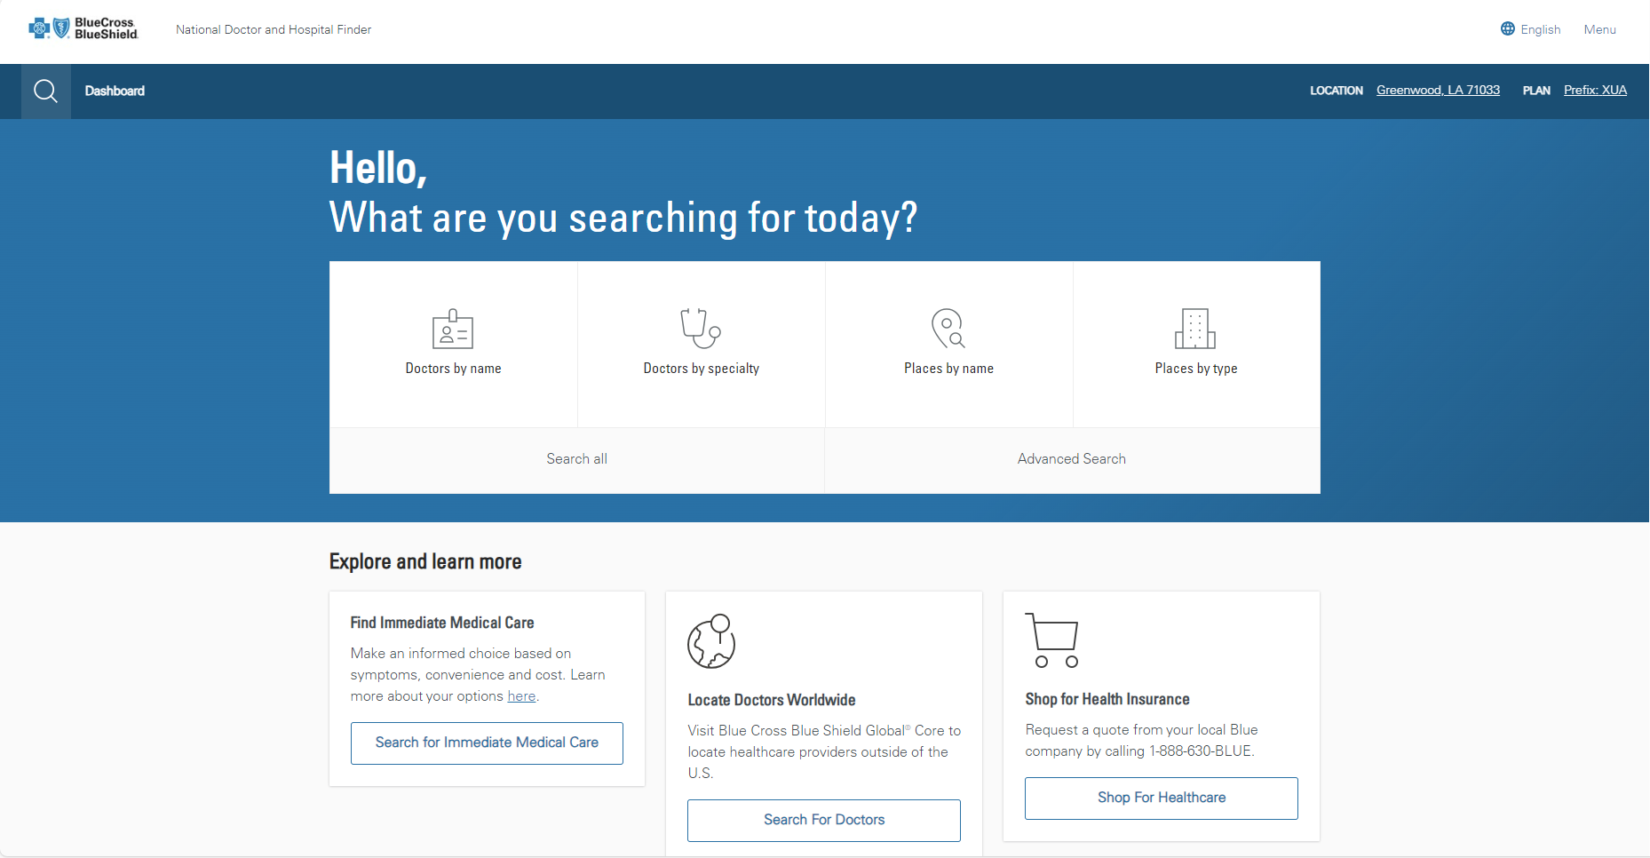
National Doctor & Hospital Finder
BlueCard helps members access coverage while traveling out of state through our National Doctor and Hospital Finder website.

Slide 48
Online Resources: Provider Page
www.lablue.com/providers
You will find information on:
Network Enrollment
Credentialing
Provider Support
Electronic Services
Learn about iLinkBlue
Clearinghouse Services
Electronic Funds Transfer (EFT)
News and Events
Network News
Product Enhancements
Blue Advantage Insights
Past Newsletters
Medical Management
Authorizations
Medical Policies
Lab Management
Care Management
Pharmacy
Programs
Quality Blue
Blue Distinction Center
Specialty Care Insight
And more!

Slide 49
More information about The BlueCard Program can be found in our online manual here:
www.lablue.com/providers >Resources >Manuals

Slide 50
Support

Slide 51
Provider Relations
Jami Zachary Director
Paden Mouton Provider Relations Manager
Mary Reising Health System Representative
Brittney Brooks
Acadia, Allen, Cameron, Evangeline, Iberia, Jefferson Davis, St. Charles, St. Mary, St. John the Baptist, St. Landry, Vermillion
Marie Davis, Senior Provider Relations Representative Avoyelles, Beauregard, Caldwell, Catahoula, Concordia, East Carroll, Franklin, LaSalle, Madison, Morehouse, Ouachita, Rapides, Richland, Tensas, Vernon, West Carroll
Brittany Fields Iberville, Jefferson, Orleans, Plaquemines, St. Bernard, St. James
Mary Guy East Feliciana, Lafourche, Livingston, Pointe Coupee, St. Helena, St. Martin, St. Tammany, Tangipahoa, Terrebonne, Washington, West Feliciana
Melonie Martin Ascension, East Baton Rouge, West Baton Rouge
Lisa Roth
Online Portal Training
Amber Strahan Assumption, Bienville, Bossier, Caddo, Claiborne, Desoto, Grant, Jackson, Lincoln, Natchitoches, Red River, Sabine, Union, Webster, Winn
provider.relations@lablue.com | 1-800-716-2299, option 4

Slide 52
Provider Contracting
Jason Heck, Director – jason.heck@lablue.com
Diana Bercaw, Lead Provider Network Development Representative – diana.bercaw@lablue.com
Jefferson, Orleans, Plaquemines and St. Bernard parishes
Jordan Black, Sr. Provider Network Development Representative – jordan.black@lablue.com
Acadia, Evangeline, Iberia, Lafayette, St. Landry, St. Martin, St. Mary and Vermilion parishes
Sue Condon, Lead Network Development & Contracting Representative – sue.condon@lablue.com
West Feliciana, East Feliciana, St. Helena, Pointe Coupee, West Baton Rouge, East Baton Rouge, Livingston, Ascension and Iberville parishes
Kim Jones, Provider Network Development Representative – kim.jones@lablue.com
Caddo, Bossier, Webster, Claiborne, Desoto, Red River, Bienville, Sabine, Natchitoches and Winn parishes
Cora LeBlanc, Sr. Provider Network Development Representative – cora.leblanc@lablue.com
Assumption, St. John The Baptist, Terrebonne, St. Mary, Lafourche, St. Charles, St. James, St. Tammany, Tangipahoa and Washington parishes
Dayna Roy, Sr. Provider Network Development Representative – dayna.roy@lablue.com
Allen, Avoyelles, Beauregard, Calcasieu, Cameron, Grant, Jefferson Davis, Rapides and Vernon parishes
Lauren Viola, Provider Network Development Representative – lauren.viola@lablue.com
Jackson, Lincoln, Tensas, Madison, East Carroll, West Carroll, Franklin, Richland, Morehouse, Ouachita, Caldwell, Union, Concordia, Catahoula and Lasalle parishes
provider.contracting@lablue.com | 1-800-716-2299, option 1
Notes:
updated

Slide 53
Provider Credentialing & Data Management
Provider Network Setup, Credentialing, Contracting & Demographic Change
Sam Measels, Director, Provider Credentialing and Information
sam.measels@lablue.com
Kaci Guidry, Manager, Provider Data Management & PCDM Status
kaci.guidry@lablue.com
Kristin Ross, Manager, Provider Contract Administration
kristin.ross@lablue.com
If you would like to check the status on your credentialing application or provider data change or update, please contact the Provider Credentialing & Data Management Department.
PCDMstatus@lablue.com | 1-800-716-2299, option 2

Slide 54
Quick Contacts
Joining the Network
Getting Credentialed – PCDMstatus@lablue.com, 1-800-716-2299, option 2
Getting Contracted – provider.contracting@ lablue.com, 1-800-716-2299, option 1
Updating your Information
Data Management – PCDMstatus@ lablue.com, 1-800-716-2299, option 2
Education, iLinkBlue Training & Outreach
Provider Relations – provider.relations@ lablue.com, 1-800-716-2299, option 4
Electronic Services
iLinkBlue – www.lablue.com/ilinkblue
EDI Services (clearinghouse) – EDIservices@ lablue.com, 1-800-716-2299, option 3
Security Access to Online Services – PIMteam@ lablue.com, 1-800-176-2299, option 5
Ongoing Support
Customer Care & IVR Phone Services – 1-800-922-8866

Slide 55
Questions?
At this time, we will address the questions you submitted electronically through the webinar platform.

Slide 57
Appendix

Slide 58
Ancillary Claims
Ancillary providers include Independent Clinical Laboratory, Durable/Home Medical Equipment and Supplies and Specialty Pharmacy providers.
Please note:
If you contract with more than one Plan in a state for the same product type (i.e., PPO or traditional), you may file the claim with either Plan.
Contiguous county claims filing rules do not apply to ancillary claims.

Slide 59
Dental and Oral Surgery Claims ADA Claim Form
When filing claims/calling for claim status for dental services, providers use the information on the Blue Plan named on the member ID card.
ADA claim forms received by Louisiana Blue for dental services for BlueCard members will be sent back to the provider.
Dentists and oral surgeons should verify benefits for BlueCard program members prior to performing services by calling the number on the back of the member ID card.

Slide 60
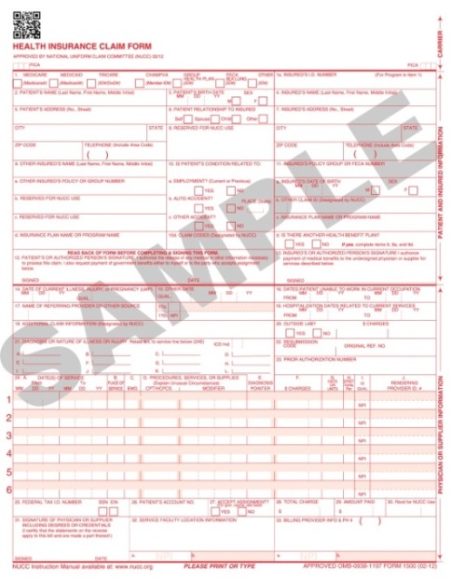
Dental and Oral Surgery Claims CMS-1500
Dental services that fall under the medical care category and are filed on a CMS-1500 claim form will be processed by Louisiana Blue. Once Louisiana Blue receives the claim, we will electronically route the claim to the member’s Blue Plan. The member’s Blue Plan then applies benefits, approves payment and routes the claim back to Louisiana Blue. Louisiana Blue will then reimburse you.
Dental claims submitted on a CMS-1500 claim form may be processed through BlueCard; therefore, providers should expect the remit or payment to come from Louisiana Blue if the claim is processed to pay the provider.
Claims may also be submitted electronically on iLinkBlue.
Additional information is available in the Dental Network Office Manual, available online at www.lablue.com/providers >Resources.
Note: Our member benefit plans require oral surgery claims be processed first under the patient’s dental coverage. Do not submit as a medical claim first.

